Slide 1
CIRCUIT THEOREMS & conversions

Slide 2
practical voltage source
Compare a practical voltage source to an ideal source:
The voltage across its terminals, A and B, remains fixed regardless of the value of load resistance that may be connected across its output

Slide 3
practical voltage source
The ideal voltage source has an internal resistance of zero

Slide 4
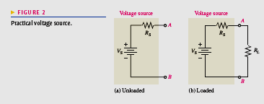
practical voltage source
Rs is the internal source resistance and Vs is the source voltage

Slide 5
practical voltage source
a). is
the internal source resistance and is the source voltage.
With no load, the output voltage is VS. This voltage is sometimes called the open circuit voltage.

Slide 6
practical voltage source
a). is
the internal source resistance and is the source voltage.

Slide 7
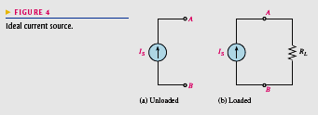
PRACTICAL CURRENT SOURCE
This an ideal current source produces a constant value of current through a load, regardless of the value of the load.

Slide 8
PRACTICAL CURRENT SOURCE
The ideal current source has an infinitely large internal parallel resistance.

Slide 9
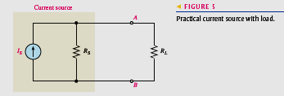
PRACTICAL CURRENT SOURCE
A practical current source representation is shown in Figure 5.
Here the internal resistance appears in parallel with the ideal current source.

Slide 10
PRACTICAL CURRENT SOURCE
As long as RL remains much smaller than RS the current through RL will stay almost constant, no matter how much RL changes

Slide 11
SOURCE CONVERSIONS
Converting a Voltage Source to a Current Source

Slide 12
SOURCE CONVERSIONS

Slide 13
SOURCE CONVERSIONS
The value of RS is the same for both the voltage and current sources.
The directional arrow for the current points from minus to plus.

Slide 14
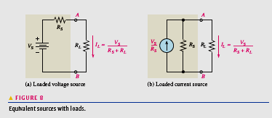
SOURCE CONVERSIONS

Slide 15
SOURCE CONVERSIONS
For any given load resistance connected to the two sources, the same load voltage and load current are produced by both sources.

Slide 16
SOURCE CONVERSIONS
Equivalency of two sources means that for any given load resistance connected to the two sources,
the same load voltage and load current are produced by both sources. This concept is called terminal equivalency.

Slide 17
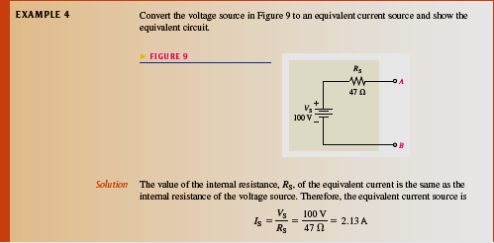
SOURCE CONVERSIONS

Slide 18
SOURCE CONVERSIONS

Slide 19
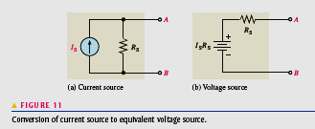
Converting a Current Source to a Voltage Source
The source current IS, multiplied by the internal source resistance RS, gives the value of the equivalent source voltage VS.

Slide 20
Converting a Current Source to a Voltage Source

Slide 21
Converting a Current Source to a Voltage Source
The source current, multiplied by the internal source resistance, gives the value of
the equivalent source voltage. The source current, multiplied by the internal source resistance, gives the value of
the equivalent source voltage.
The polarity of the voltage source is minus to plus in the direction of the current.
The equivalent voltage source is the voltage in series with as illustrated in Figure 11.

Slide 22
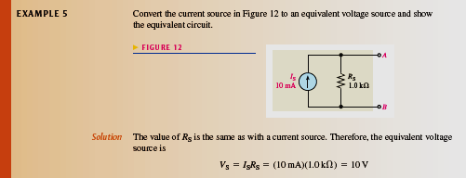
Converting a Current Source to a Voltage Source

Slide 23
THE SUPERPOSITION THEOREM
The steps in applying the superposition method are as follows:

Slide 24
THE SUPERPOSITION THEOREM
The steps in applying the superposition method are as follows:

Slide 25
THE SUPERPOSITION THEOREM
The steps in applying the superposition method are as follows:

Slide 26
THE SUPERPOSITION THEOREM

Slide 27
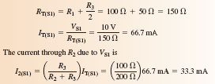
THE SUPERPOSITION THEOREM

Slide 28
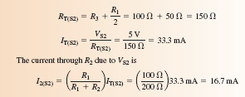
THE SUPERPOSITION THEOREM

Slide 29
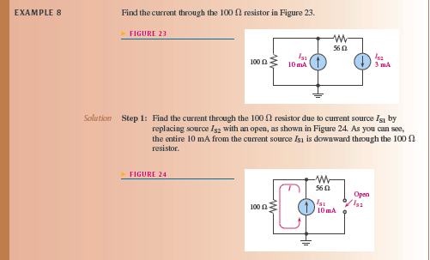
THE SUPERPOSITION THEOREM

Slide 30
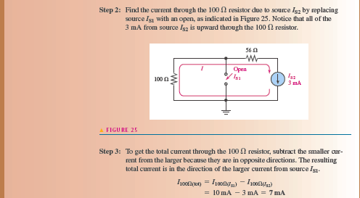
THE SUPERPOSITION THEOREM

Slide 31
THEVENIN’S THEOREM
Thevenin’s theorem can be used to simplify the analysis of complex circuits.

Slide 32
THEVENIN’S THEOREM
The values of the equivalent voltage and resistance depend on the values in the original circuit.

Slide 33
THEVENIN’S THEOREM
The Thevenin equivalent resistance (RTH) is the total resistance appearing between
two terminals in a given circuit with all
sources replaced by their internal resistances.
The Thevenin equivalent
voltage (VTH) is the open
circuit (no-load) voltage
between two output terminals
in a circuit

Slide 34
THEVENIN’S THEOREM

Slide 35
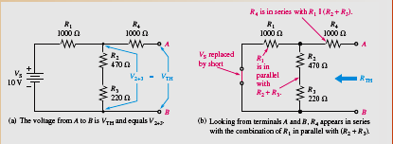
THEVENIN’S THEOREM

Slide 36
THEVENIN’S THEOREM

Slide 37
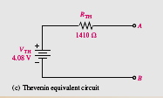
THEVENIN’S THEOREM
The resulting Thevenin equivalent circuit is shown in Figure 34(c).

Slide 38
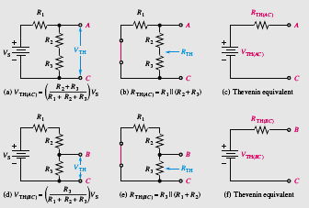
THEVENIN’S THEOREM
Example of a circuit thevenized from two different sets of terminals.

Slide 39
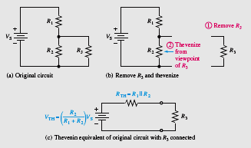
THEVENIN’S THEOREM
Example of thevenizing a portion of a circuit.
In this case, the circuit is thevenized from the viewpoint of the load resistor, R3.

Slide 40
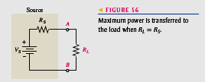
MAXIMUM POWER TRANSFER THEOREM
For a given source voltage, maximum power is transferred from a source to a load when the load resistance is equal to the internal source resistance. RL = RS

Slide 41
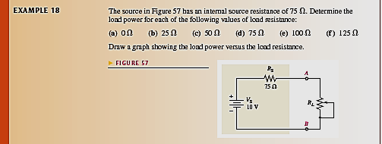
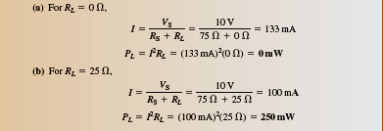
MAXIMUM POWER TRANSFER THEOREM

Slide 42
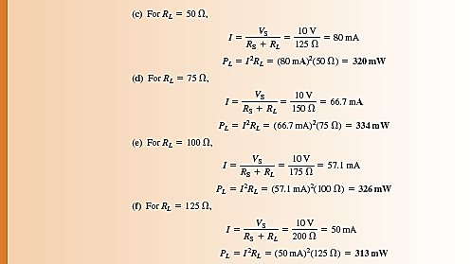
MAXIMUM POWER TRANSFER THEOREM

Slide 43
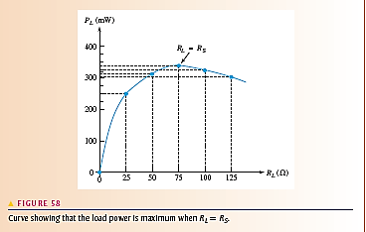
MAXIMUM POWER TRANSFER THEOREM

Slide 44
MAXIMUM POWER TRANSFER THEOREM
Practical applications of the maximum power transfer theorem include audio systems such as stereo, radio, and public address.
In these systems the resistance of the speaker is the load. The circuit that drives the speaker is a power amplifier.
The systems are typically optimized for maximum power to the speakers.
Thus, the resistance of the speaker must equal the internal source resistance of the amplifier

Slide 45
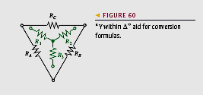
-to-Y Conversion∆
Conversions between ∆to-Y and Y-to- ∆ type circuit arrangements are useful in certain specialized three-terminal applications.
One example is in the analysis of a loaded Wheatstone bridge circuit.

Slide 46
-to-Y Conversion∆
To convert from delta to wye, you need R1, R2,and R3 in terms of RA, RB, and RC. The conversion rule is as follows:

Slide 47
-to-Y Conversion∆

Slide 48
Y -to- ∆ Conversion

Slide 49
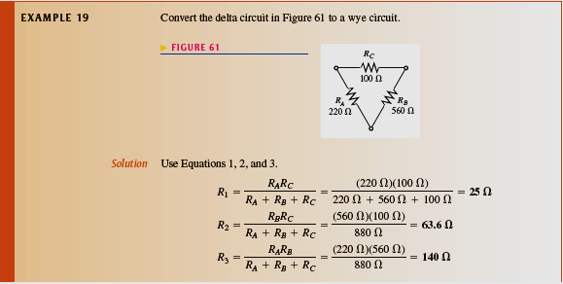
-to-Y Conversion∆

Slide 50
-to-Y Conversion∆

Slide 51
Application of ∆ -to-Y Conversion to a Bridge Circuit
Now you will see how ∆ -to-Y conversion can be used for converting a bridge circuit to a series-parallel form for easier analysis.

Slide 52
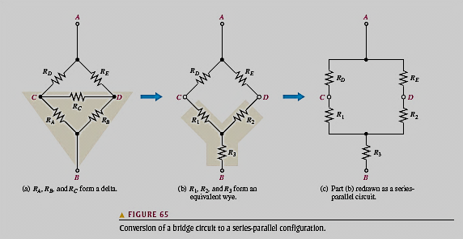
Application of ∆-to-Y Conversion to a Bridge Circuit
In a bridge circuit, the load is connected between terminals C and D.
In Figure 65(a), RC represents the load resistor.

Slide 53
Application of ∆-to-Y Conversion to a Bridge Circuit
When voltage is applied across terminals A and B, the voltage from C to D (VCD) can be determined using the equivalent series-parallel circuit in Figure 65(c) as follows.

Slide 54
Application of ∆-to-Y Conversion to a Bridge Circuit

Slide 55
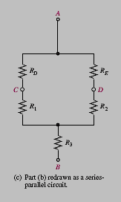
Application of ∆-to-Y Conversion to a Bridge Circuit
Then, the resistance of the parallel
portion of the circuit in Figure 65(c) is

Slide 56
Application of ∆-to-Y Conversion to a Bridge Circuit

Slide 57
Application of ∆-to-Y Conversion to a Bridge Circuit

Slide 58
Application of ∆-to-Y Conversion to a Bridge Circuit

Slide 59
Application of ∆-to-Y Conversion to a Bridge Circuit

